Slide 1
Learning Complex Behaviours and Keepaway in Robocup 3D
~ Nilesh Gupta

Slide 2
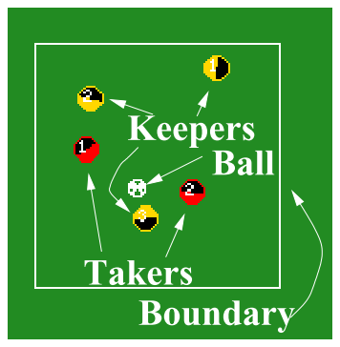
KeepAway
“Keepers”, tries to keep control of the ball for as long as possible despite the efforts of “Takers”.

Slide 3
Challenges in Keepaway
Large and continuous state space, “curse of dimensionality”
Hidden state, agent has only a partial world view
Noisy sensors and actuators, do not perceive the world exactly as it is, nor can they affect the world exactly as intended
Asynchronous, perception and action cycle different
Distributed and multi-agent domain with teammates and adversaries

Slide 4
Keepaway in 2D
Paper by P. Stone and R. Sutton describes the learning of higher-level decisions in 2D keepaway
Modelled keepaway as an SMDP, keepers learn independently, takers strategy fixed
Used Sarsa(λ) with linear tile-coding function approximation and variable λ

Slide 5
3D Robocup Domain Description
Each robot has 22 degrees of freedom : six in each leg, four in each arm, and two in the neck
Agent is equipped with joint perceptors and effectors
Noisy visual information about the environment is given to an agent every third simulation cycle (60 ms)
Agents can communicate with each other every other simulation cycle (40 ms)

Slide 6
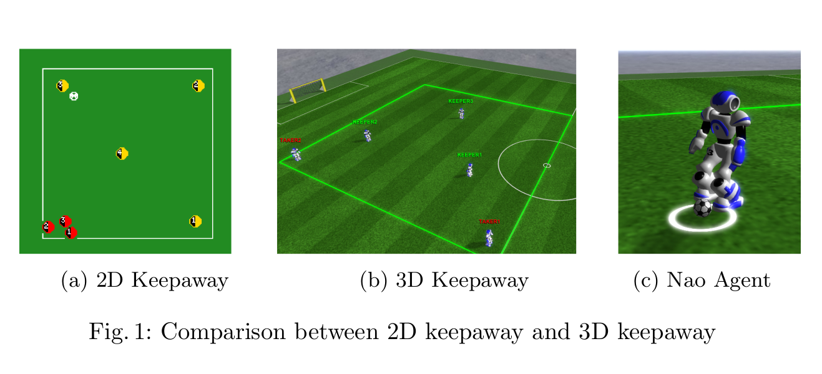
Additional Challenges in 3D Robocup

Slide 7
Additional Challenges in 3D Robocup
2D robocup provides convenient primitive action such as turn(angle), dash(power), or kick(power, angle)
Primitives in 3D robocup include apply specified amount of torque on specified hinge.
To achieve a dash or kick, the agent has to figure out correct sequence of torque values to apply across all it’s 22 hinges over different timesteps

Slide 8
UT Austin’s 2011 Base Code
Luckily we didn’t had to start from scratch!
Omnidirectional walk engine based on a double inverted pendulum model
A couple basic skills for kicking, one of which uses inverse kinematics
Particle filter for localization and Kalman filter for tracking objects
All necessary parsing code for sending/receiving messages from/to the server

Slide 9
How to get keepaway working in 3D domain
Optimise existing basic skills as per keepaway requirements
Learn complex behaviours such as getting possession of the ball
Learn high level decision making policy for keepers

Slide 10
Kick Optimization

Slide 11
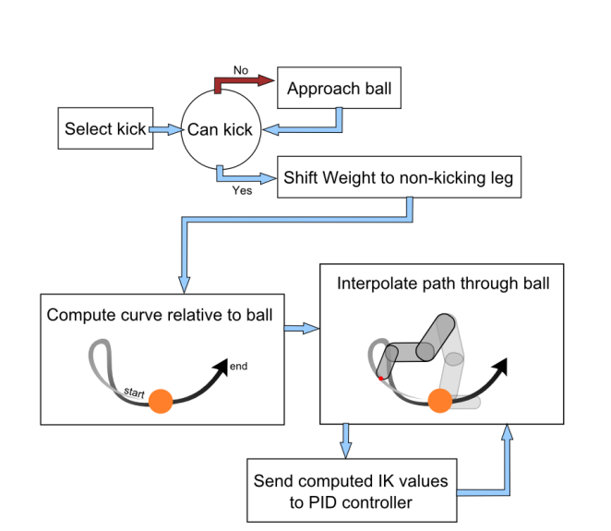
Kick Engine
For playing keepaway, a robust, precise and mid-range (since keepaway is played within a confined boundary) kick is required.
UT’s kick need to be optimized

Slide 12
Kick Optimization
Agent Born
Execute Kick
We optimize IK kick with respect to the control points of kick trajectory
Used CMA-ES for optimization
candidate parameter is evaluated over 12 episodes
Update Fitness
Ball Stops

Slide 13
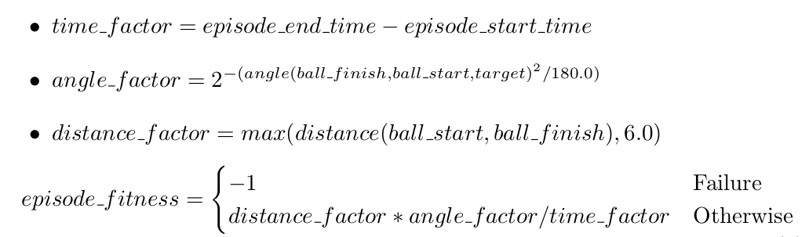
Fitness Function

Slide 14
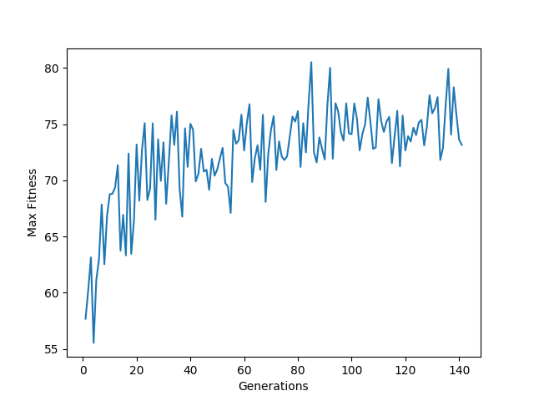
Learning Curve

Slide 15
Learning to Get Possession of Ball

Slide 16
Getting Possession of Ball
Not easy! Different actions suitable for different scenarios
We define following 4 primitive actions to choose from :
INTERCEPT : move(intercept point), where intercept point is defined as the point perpendicular to ball’s trajectory from agent’s position
GO TO FINISH : move(ballfinish), where ballfinish is ball’s finish position
POSITION : try to position around the ball to prepare for the kick
HOLD : remain still at current location
Need to learn which action to choose based on current world state

Slide 17
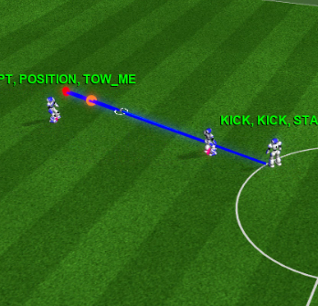
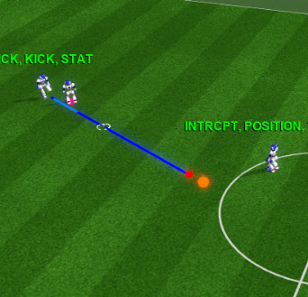
Getting Possession of Ball
Better To Intercept
Better To Go to Finish

Slide 18
Getting Possession of Ball

Slide 19
Complex Behaviour
Any behaviour which requires combination of primitive actions based on world state to achieve the goal
We represent a complex behaviour as a state machine whose transitions are governed by the world state
ComplexBehaviour : (invoke, abort, getSkill, action_map, state, nextstate)

Slide 20
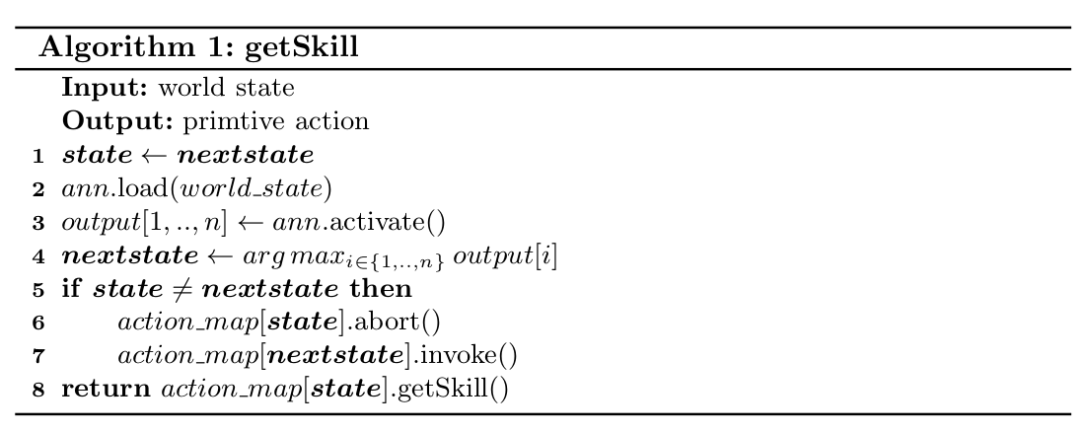
Control by ANNs
state transitions define the control of a complex behaviour
state transitions can be defined using an ANN

Slide 21
Optimising Control
We can optimise ANN to suit our goal but no well defined loss function, too much variance
Can define a reward function as how well a particular candidate did on the task, evaluate over few episodes (~20) to reduce variance
We try to optimise the ANN using Neuro Evolution of Augmenting Topologies (NEAT)
NEAT is a genetic algorithm for the generation of evolving artificial neural networks

Slide 22
Initialising NEAT with good candidates
3D simulations are computationally expensive, need to be sample efficient
Start NEAT with good seed to minimize the training time and motivate the optimisation towards the candidates that we expect to be good
Imitate a human behaviour of state transitions to generate good seed

Slide 23
Results on Keepaway

Slide 24
3 vs 2 Keepaway : High-level decision policy

Slide 25
Keepers
At any instant each keeper takes a role, named K1, K2 and K3.
K1 : keeper closest to ballfinish, K1 decides role of other players, let K1 selects T as its kick target
K2 : keeper closest to T, tries to move to position T
K3 : remaining keeper, tries to go to its home position

Slide 26
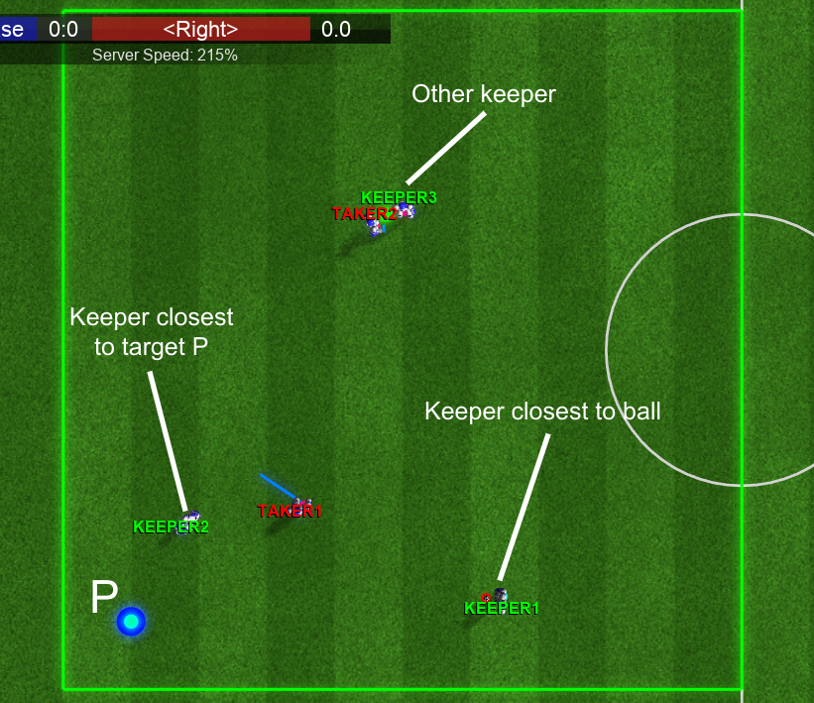
Keepers

Slide 27
K1 Keeper
K1 evaluates the best target position T and tries to get possession of the ball
If K1 has ball’s possession and takers are far away, holds the ball
Else attempts to kick at target T
So, essentially the choices K1 can learn are the choices of target T based on the state of keepaway
We hope to learn better choices of target T to yield long episodes of keepaway

Slide 28
Takers
Takers strategy is fixed and they don’t try to learn or improve their strategy
GREEDY+RANDOM : the taker closest to the ball’s position greedily moves towards the ball
The other taker randomly selects a keeper other than K1 and follows this randomly selected keeper.
To avoid thrashing, the random selection of the keeper to follow is only done when a pass is made

Slide 29
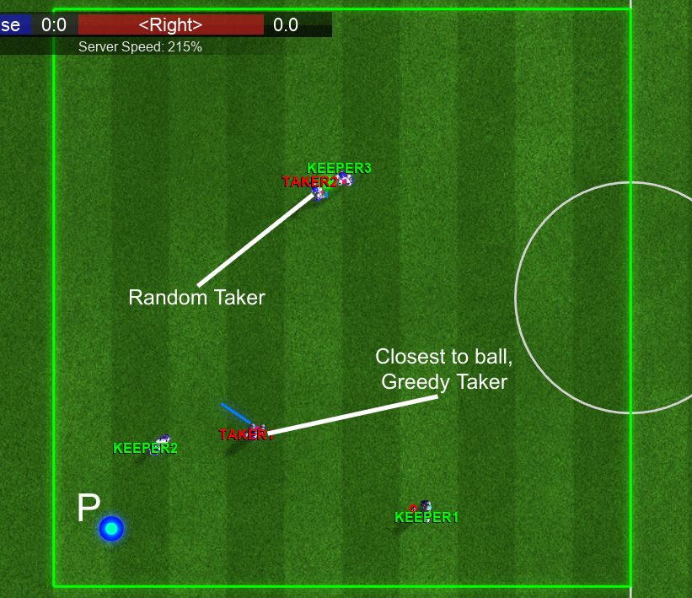
Takers

Slide 30
Mapping Keepaway onto NEAT optimisation
Select targets from continuous domain, not feasible or desirable
Select target from a finite set S of points spread out across the field
Action space very large for RL methods to gather enough sample to learn
learn a function cost(F) which scores each point in S based on features from F

Slide 31
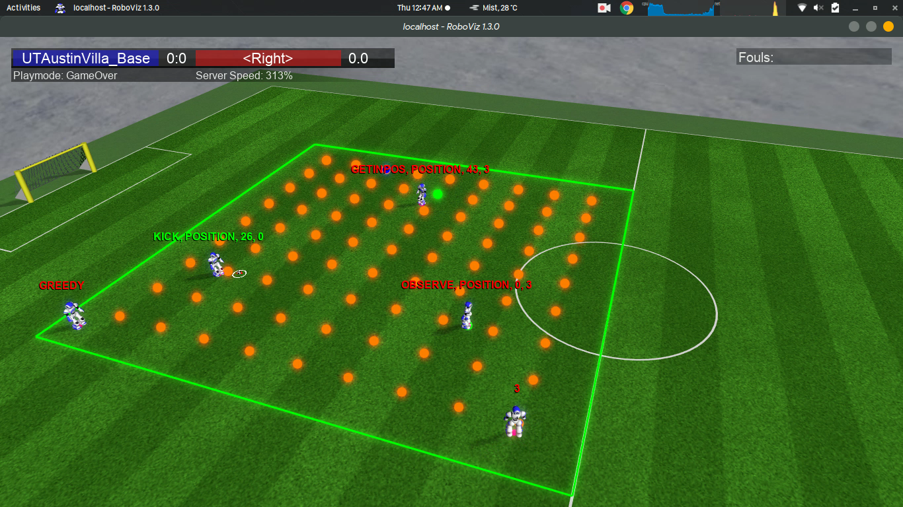
Snapshot of Keepaway

Slide 32
Learning Evaluation Function
Represent the evaluation function as a neural network that computes a real value for a target location p ∈ S given input features
Use NEAT to learn the neural network behind the evaluation function
A particular candidate f is evaluated on 20 episodes of keepaway and the reward for each episode is number of passes made in that episode

Slide 33
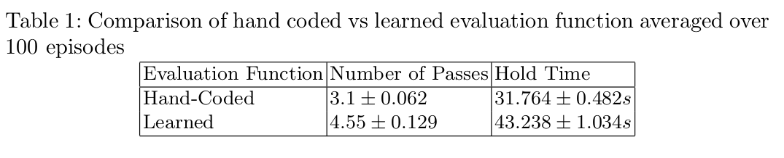
Results

Slide 34
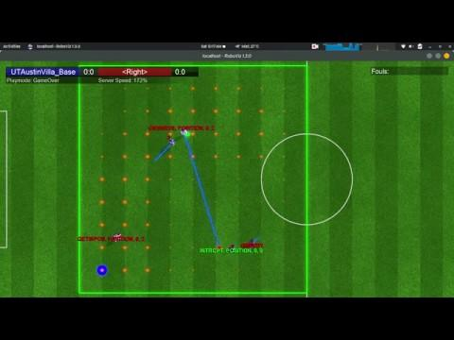
Demo

Slide 35
Thank You!

